Slide 1
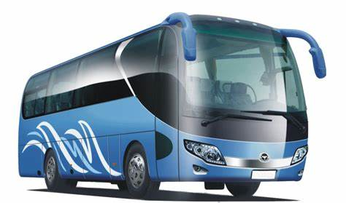
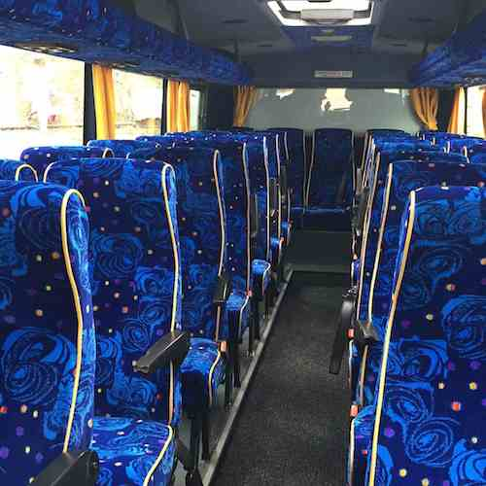
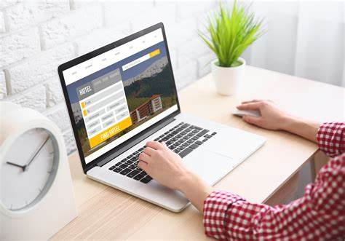
ONLINE BUS RESERVATION SYSTEM
Developed By :
2203A51540 B.Swarna

Slide 2
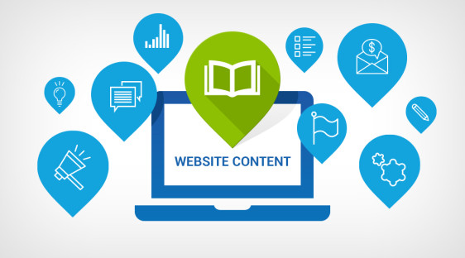



contents
Introduction
Design
Conclusion
References

Slide 3
introduction
Online Bus Ticket Reservation System is Windows based application that works within centralized network. The software program “Online Bus Reservation System” provides bus transformation system, a facility to reserved seats, cancellation of seats and different types of enquiry which need an instant and quick reservation. OBTRS is built for manage and computerize the traditional database, ticket booking and tracking bus and travel made easy. It maintains all data’s of users, bus details, reservation details, booking details, customer details.

Slide 4
Problem statement :
System that are using by the staff at the counter currently is an internal system and just used to sell the bus ticket at the counter. Customer has to go to the counter to buy bus ticket or ask for bus schedule. Further, customers need to pay cash when they buy the bus ticket and sometimes needs to queue up long time to get the bus ticket. Besides that, customer also not allowed to buy bus ticket through telephone and the bus company’s telephone always-busy line.

Slide 5
solution
The method to solve this problem is to crate an online booking bus ticket system. Customer can buy the book ticket over the internet, 24 hours a day, 7 days a week and the bus ticket can’t be lost, stolen or left behind. In addition, the online system lets the customers check the availability of the bus ticket before they buy bus ticket. Furthermore, customers no need to pay cash to buy bus ticket because they can pay the bus ticket on the traveling time.

Slide 6
scope
The scope of the online bus ticket reservation system is :
A person should be able to
Login to the system through the first page of the application.
Change the password after logging into the system.
Should be able to create a new login for the accessing the reservation facility.
Query the buses for two weeks (Only two weeks advance reservation is available).

Slide 7
No reservation before two days can be done.
Able to choose the seats which are available for a certain class.
Give details about the credit card.
Improved & optimized service.

Slide 8
design
System design included designing of software and hardware i.e., functionally of hardware and software id separated-out. After separation, design of software modules is done. The design process translates requirements into representation of the software that can be assessed for quality before generation of code begins.

Slide 9
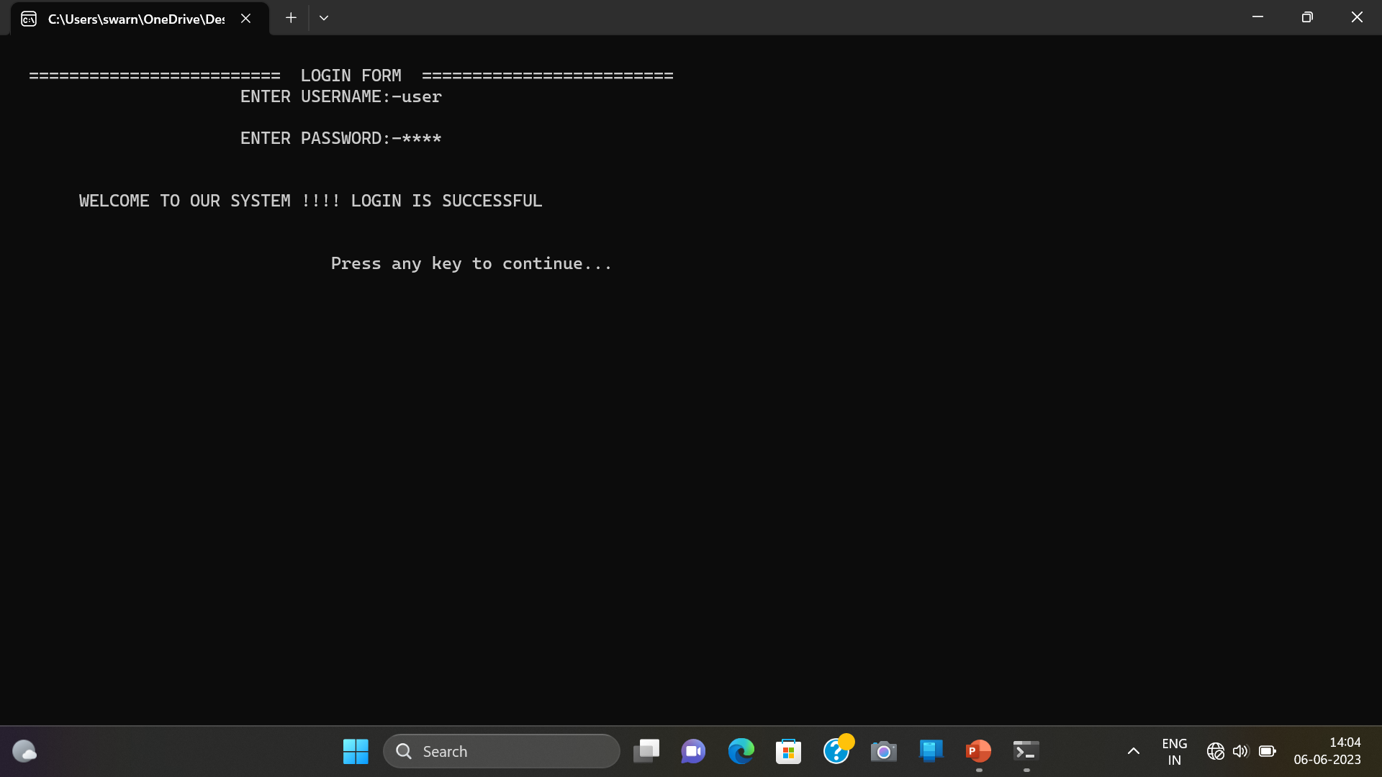
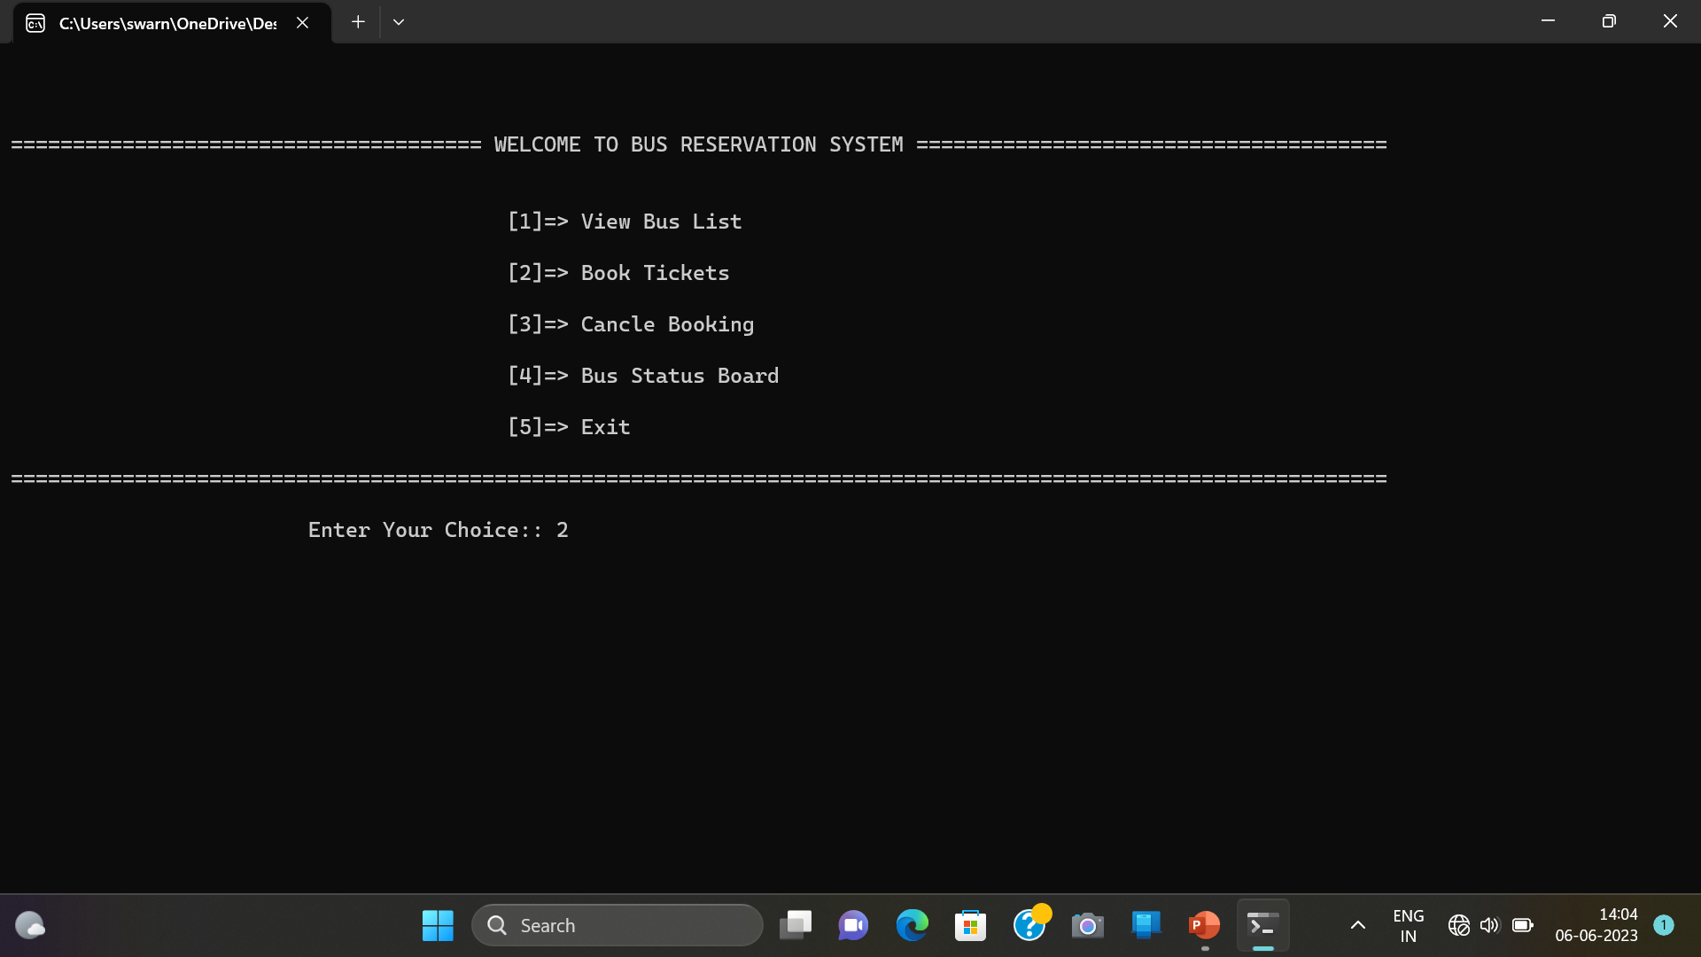

Slide 10
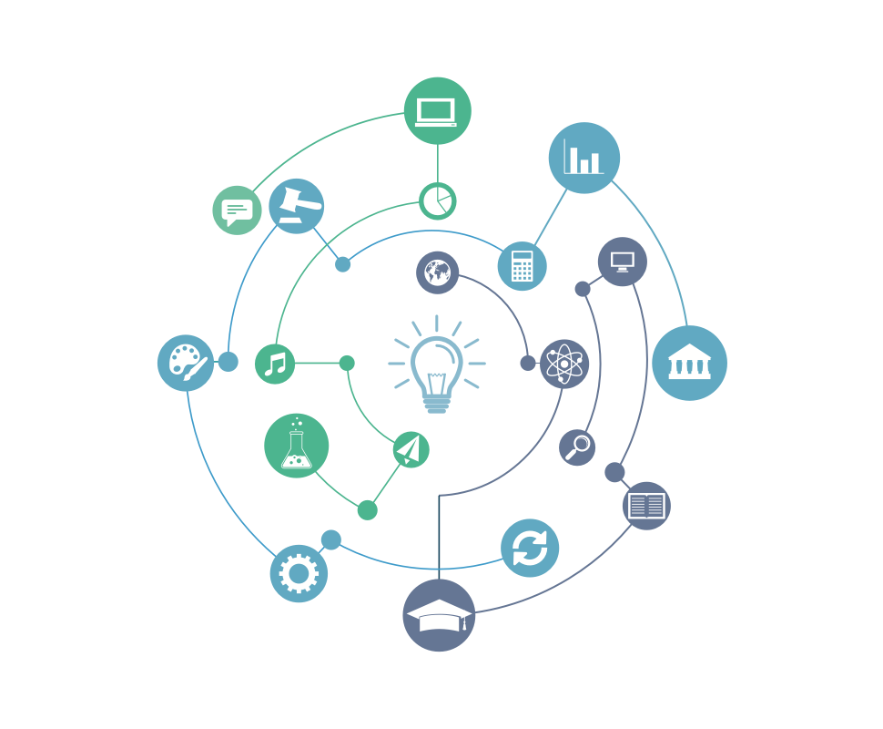
Important Features
It simplifies the tasks and reduces paper work.
Accuracy.
User Friendly
Availability.
Efficiency.
Reliable.
Durable.

Slide 11
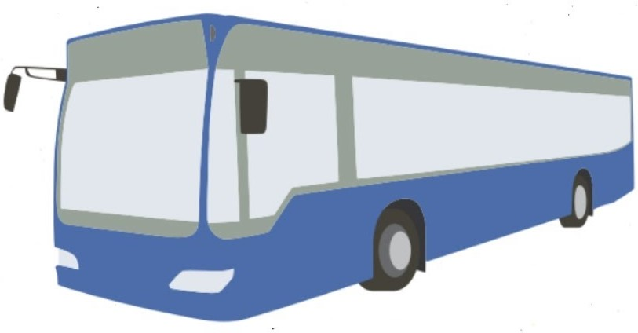
conclusion
It provides Online Bus Ticket Reservation System.
This system is user friendly and accurate.
This system is available 24 hours and efficient in reservation.
Its has no hidden costs in fares.

Slide 12




